Slide 1
SRS DOCUMENT CREATION
TS- WEB DEVELOPMENT CAPSTONE PROJECT
Presented By:
1. Sandhya Pagoti – RGUKT Srikakulam (B.Tech)
2. Santoshi Mullu – RGUKT Srikakulam (B.Tech)
3. Navyasri Neelapu – RGUKT Srikakulam (B.Tech)
Guided By:
Uma maheshwari Madam

Slide 2
OUTLINE
Abstract
Problem Statement (Should not include solution)
Aims , Objective & Proposed System/Solution
System Design
System Development Approach(Technology Used)
Algorithm & Deployment
Conclusion
Future Scope

Slide 3
Abstract
The lack of a software tool to automate the creation of a well-defined, Natural Language Software Requirements Specification (SRS) document is an obstacle to the process of efficient Requirements Engineering (RE). This paper provides an overview of a methodology and a novel software tool that attempt to formalize and automate the RE process, and it expands on the use of the SRS Documentation component of the tool that generates automatically a Well structured Natural Language SRS Document.
Keywords- automated SRS; automated RE; Natural Language RE

Slide 4
Problem Statement
Every project begins with a requirement. Understanding the types of users and their requirements is the most important part of a project. Each type of user may have their own requirements. The project must make sure to cover all of them. But just knowing the requirements is also not enough, it is also important to lay out the groundwork for fulfilling the requirements. The document must be made with precision. Not everyone has time to work on every single word written on the document.

Slide 5
Proposed Solution
Software Requirements Specific document completes the need for the above problem statement. The SRS document allows the developers to execute the project as required. To free people from the hassle of constructing the whole document from scratch, we bring a Web based App which will generate the SRS document based on the details given by the user about their project. This way, the developers only need to work on the idea and requirements of the users. The documentation will be constructed just by stating the same.

Slide 6
System Architecture
The System Architecture of Software Requirement Specification consists two parts:
1.Front-end
2.Back-end
Front- end provides an interface to the user to give all the details of his project in order to generate a proper SRS Document based on the given details.
Back-end includes a database that will store all the credentials of the user which will help user to login in order to access the service provided.

Slide 7
System Deployment Approach
1. The Front – end part of this system is developed using HTML, CSS, Javascript for Home page, login, register and to take the details of the project from the user.
2. The Back - end part of the system is developed using PHP and MySql for storing the user credentials in a database while register/login which will be used to check the authentication of the user.

Slide 8
Algorithm & Deployment
SRSDC is a web application. When a user wants to create a SRS Document, he/she must be login.
If he/she is a new user then the user must register.
After registration, the user login to the page and provide details of their project according to the title.
Then user check the entire document by clicking “page check”.
After confirmation of the page, user can print the document in a well document structure.

Slide 9
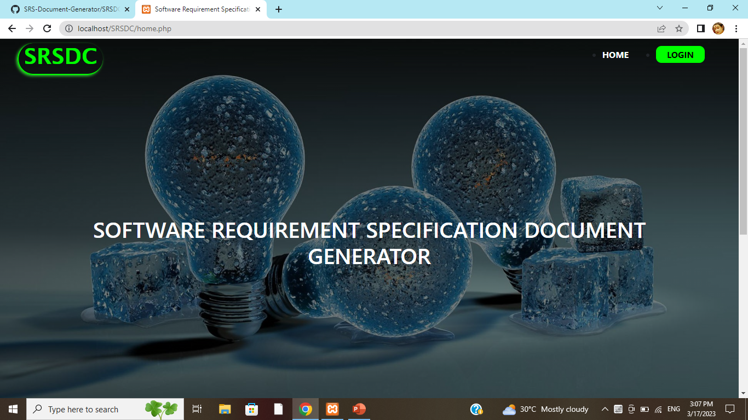

Slide 10
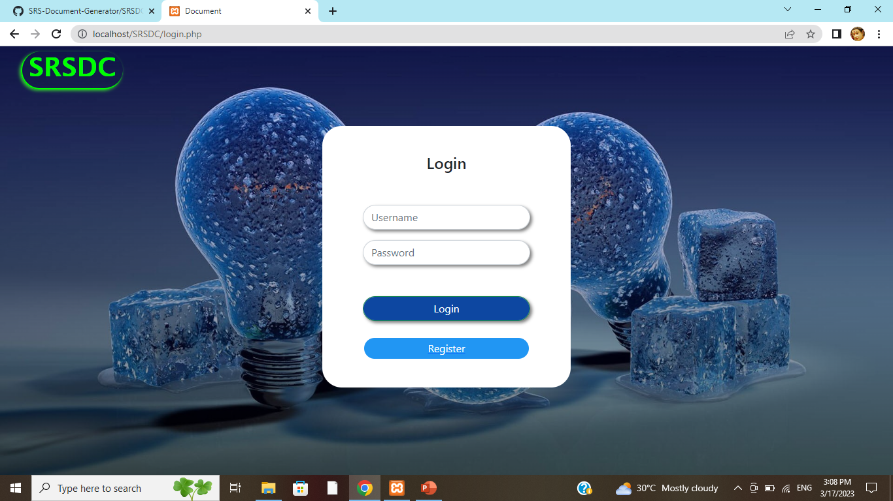

Slide 11
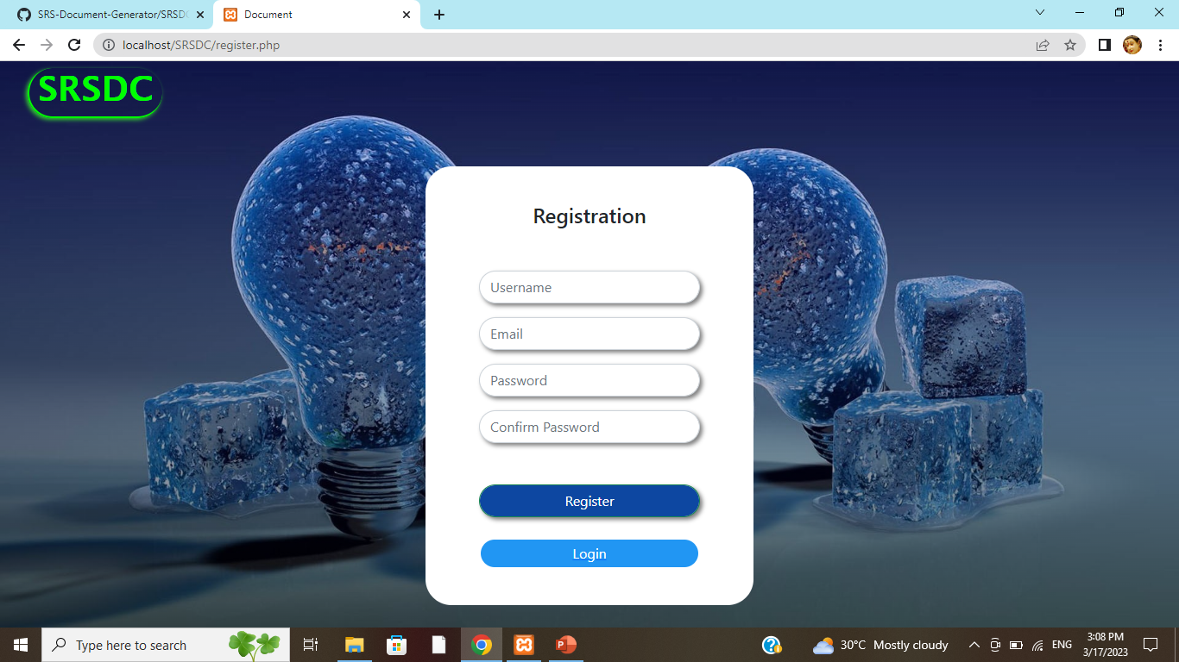

Slide 12
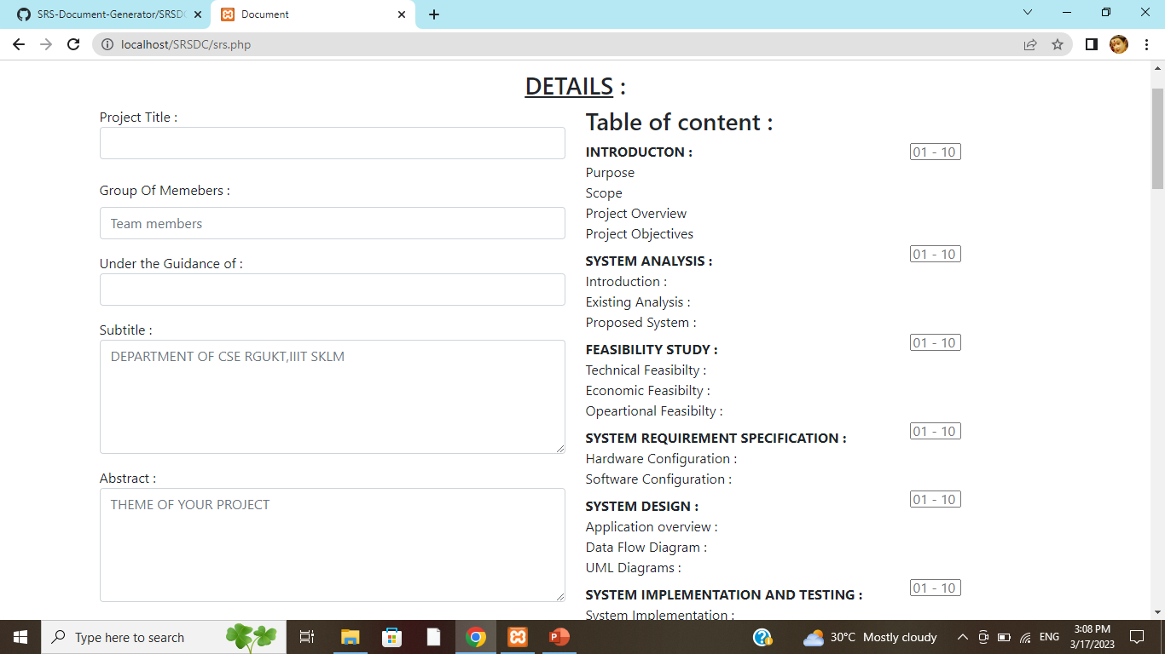

Slide 13
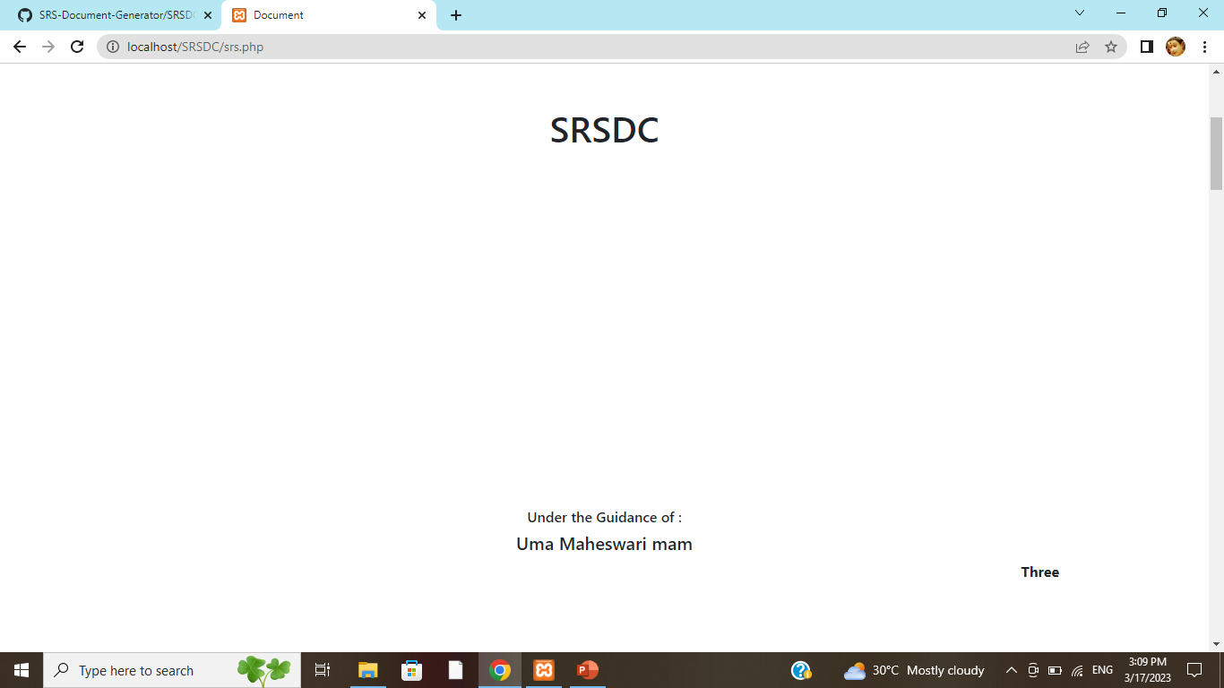

Slide 14
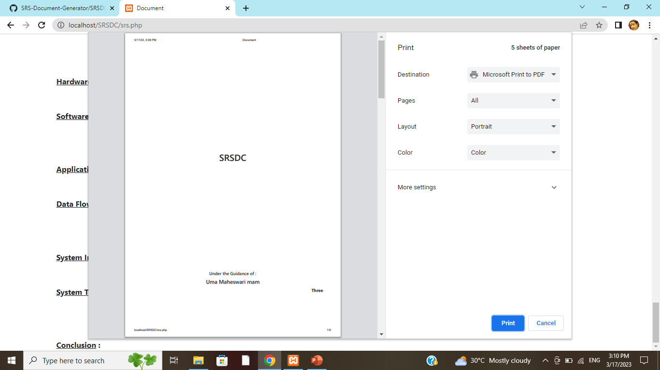

Slide 15
THANK YOU

